Slide 1

The 5 Top Dynamics CRM Ribbon Customizations
DYNAMICS CRM 2016

Slide 2

Mitch Milam
Dynamics CRM Architect
Independent consultant and trainer
Ten-Time Dynamics CRM MVP
mitch@xrmcoaches.com
infinite–x.net
@mitchmilam
http://tinyurl.com/MitchMilamLinkedIn

Slide 3
Future Events
Dynamics CRM Upgrade Strategies Deep Dive
Tuesday, July 26th, 2016 at 1:00pm Central Time (U.S.) (GMT-5:00)
In this workshop we will be discussing all aspects of upgrading your Dynamics CRM system from version 4.0 onward.
Registration ends today!
Webinar: Introduction to Dynamics CRM Project Service Automation
Friday, Jul 29, 2016 10:00 AM Central Time (U.S.) (GMT-5:00)
In this webinar we will review the installation and configuration of the new Project Service Automation feature available for Dynamics CRM Online (Spring Release).
Introduction to Dynamics CRM Development
Monday August 1st, 1:00pm Central Time (U.S.) (GMT-5:00)

Slide 4
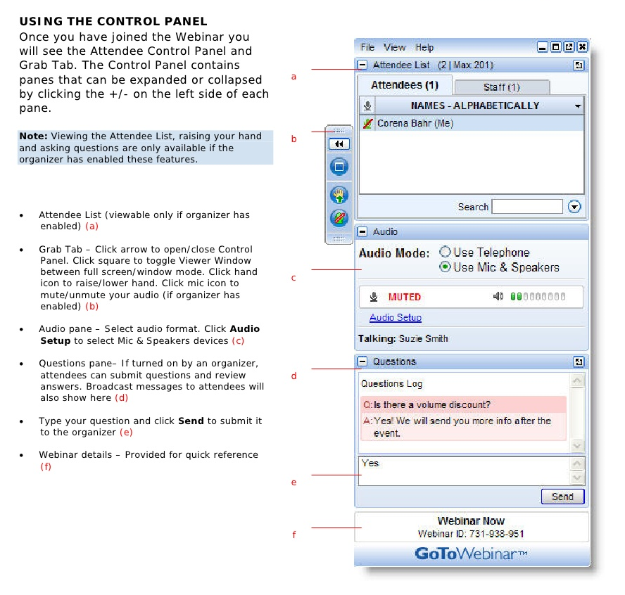
Webinar Housekeeping

Slide 5



2016 Training Roadmap
Webinars
http://www.xrmcoaches.com/webinars
KnowledgeBits
http://www.xrmcoaches.com/knowledgebits
Learning Plans
http://www.xrmcoaches.com/freestuff
More Goodies
Practice tests
On–Demand video training
Instructor–led training
Books

Slide 6
Agenda
.

Slide 7
Overview

Slide 8
Overview
RibbonDiffXml

Slide 9
Components
Command Bar
Ribbon
Tablet

Slide 10
Clients
Web
Outlook
Tablet/Mobile
Interactive Service Hub

Slide 11
Visual Components
Button
Split Button
Flyout
Menu Section
Group

Slide 12
Available Ribbons
Application Wide
Display for the entire application, no matter which page the user is on.
All Forms
Display on any entity forms
All Grids
Display on any entity view
Entity-Based
Are specific to an entity and only display on that entity

Slide 13
Ribbon Components
Commands
Enable Rules
Display Rules
Actions

Slide 14
Commands
Commands define three things
Enable Rules
When to enable the button
Display Rules
When to display the button
Actions
What to do when the user clicks the button

Slide 15
Enable Rules
Enable Rules
CommandClientTypeRule
CrmClientTypeRule
CrmOfflineAccessStateRule
CrmOutlookClientTypeRule
CustomRule
EntityRule
FormStateRule
OrRule
Enable Rules
OutlookItemTrackingRule
OutlookVersionRule
PageRule
RecordPrivilegeRule
SelectionCountRule
SkuRule
ValueRule

Slide 16
Display Rules
Display Rules
CommandClientTypeRule
CrmClientTypeRule
CrmOfflineAccessStateRule
CrmOutlookClientVersionRule
EntityPrivilegeRule
EntityPropertyRule
EntityRule
FormEntityContextRule
FormStateRule
FormTypeRule
Display Rules
HideForTabletExperienceRule
MiscellaneousPrivilegeRule
OrganizationSettingRule
OrRule
OutlookRenderTypeRule
OutlookVersionRule
PageRule
RelationshipTypeRule
SkuRule
ValueRule

Slide 17
Common Operations
Add a button
Hide a button
Unhide a button
Move a button
Change the button label
Change the button command

Slide 18
Ribbon Customization Process
Create a solution
Should hold only the entities you wish to customize
Typically separate for your normal development solution
Edit the ribbon
Publish the customizations

Slide 19
Ribbon Workbench
The only tool you should ever use to edit the ribbon.
http://www.develop1.net/public/page/Ribbon-Workbench-for-Dynamics-CRM-2011.aspx

Slide 20
Demonstrations

Slide 21
Questions?

Slide 22
Thank You

